Slide 1
Parallel Quick Sort
Dhyey Desai
Darshit Desai
Lency Lakhani

Slide 2
Quick Sort - Analogy
You know how sorting is like tidying up a messy room, but for computers?
Well, imagine you have this super cool way, QuickSort, to do it fast. But as things get bigger (like a crazy huge closet), QuickSort by itself can get a bit slow. That's where the idea of Parallel QuickSort comes in.

Slide 3
Problem:
QuickSort is a well-known sorting algorithm due to its average-case time complexity of O(n log n).
However, as datasets grow in size, sequential QuickSort may face performance challenges.
Motivated by the need for efficient sorting in high-performance computing, we explore the parallelization of QuickSort to take advantage of multiple processing units and accelerate the sorting process.

Slide 4
Problem - Analogy:
You're organizing a big pile of books. Instead of sorting them one by one, you can split the pile among friends. Each friend sorts their stack independently, and when everyone's done, you just combine the sorted stacks.
It takes advantage of many hands working at the same time, making the whole sorting job much faster, especially when you're dealing with a massive book collection.

Slide 5
Problem:
We chose C++ for implementing the parallel QuickSort algorithm due to its powerful features, efficient memory management, and support for low-level programming constructs, which are essential for optimizing parallel algorithms and achieving high performance in computational tasks.

Slide 6
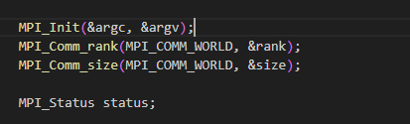
MPI Commands:
MPI_Init: Used for initializing the MPI environment.
MPI_Comm_rank: Retrieves the rank of the calling process.
MPI_Comm_size:Retrieves the size of the communicator

Slide 7
MPI Commands:
MPI Send:
MPI Receive:

Slide 8


MPI Commands:
MPI_Wtime:
Returns an elapsed time on the calling processor. Used for measuring the execution time of the program.
MPI_Finalize:
Finalizes the MPI environment, indicating that the program has finished using MPI.

Slide 9
Technical Difficulties:
One of the challenges we encountered in parallelizing the QuickSort algorithm was efficiently dividing the array among different processors. The task was to ensure that each processor received a manageable sub-array for sorting without introducing unnecessary overhead.

Slide 10
Technical Difficulties
A = int[100];
N = 6;
Then, to divide subarray for each processor we will do 100 / 6 which is nearly to 16.
But, there are still 4 elements which are not sort

Slide 11
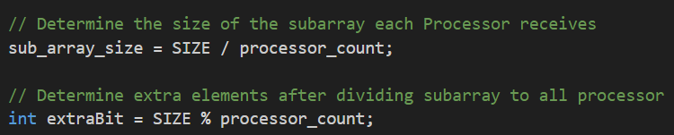
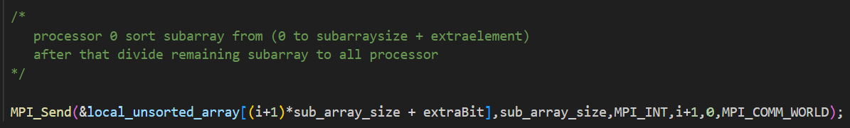
Solution

Slide 12
Another Solution
Each processor start partitioning of their respective subarray with use of pivot.
Send one part of data to another processor and again start partitioning on another part.

Slide 13
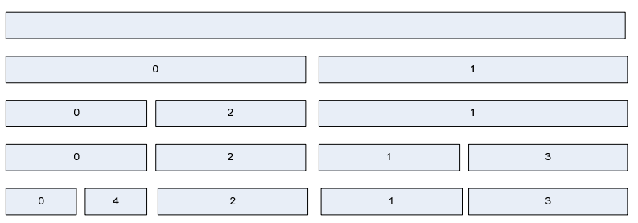
Solution

Slide 14
Shortcomings
Limited Parallelism:
Depending on the nature of the dataset, achieving high parallelism might be challenging. Certain datasets may not partition well, limiting the efficiency gains from parallel processing.

Slide 15
Shortcomings
Overhead: Introducing parallelism comes with overhead, including communication between processors and potential contention for shared resources. In some cases, this overhead may offset the benefits of parallelization for small datasets.

Slide 16
Shortcomings
Dependency on Processor Count:
The performance of the parallel QuickSort implementation could be sensitive to the number of available processors. If the number of processors is not optimal or changes dynamically, the efficiency of the parallelization strategy may be affected.

Slide 17
Conclusion:
In concluding our exploration of Parallel QuickSort, we've witnessed its prowess in accelerating the sorting of extensive datasets.
Key Takeaways:
Strengths: Speed, scalability, and adaptability make Parallel QuickSort effective for high-performance sorting tasks.
Challenges: Load imbalance and communication overhead demand careful consideration in optimizing its performance.

